Slide 1
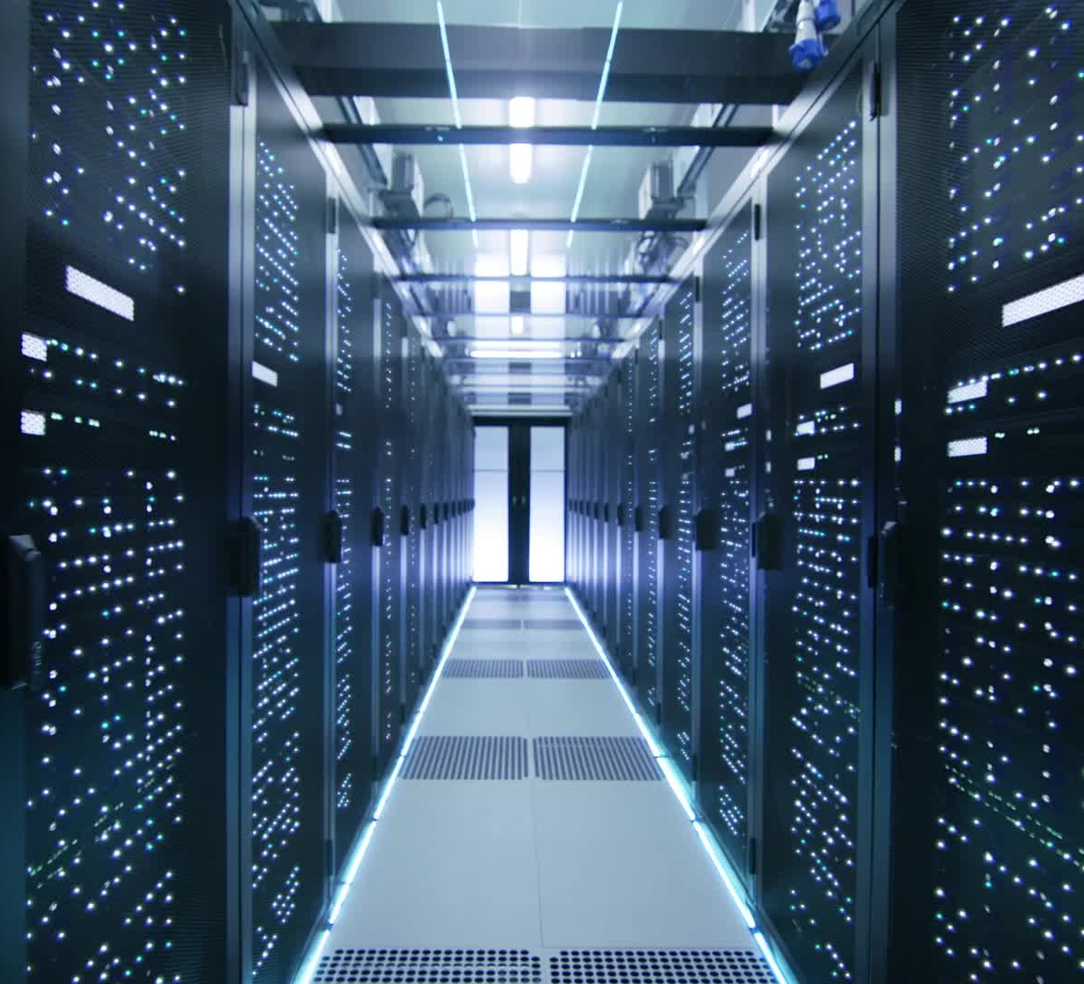
IT Infrastructure and Support Solution for Ubuntu Innovations
Enhancing technology with reliable infrastructure and support
Notes:
AI-generated content may be incorrect. ---

Slide 2
Project Context and Overview
Notes:
IT Infrastructure and Support Solution Overview, Project Introduction: IT Infrastructure for Ubuntu Innovations, Project Scope and Objectives, Organizational and Operational Context

Slide 3

IT Infrastructure and Support Solution Overview
Comprehensive IT Solution
The solution covers hardware, software, network, security, backup, and support tailored to Ubuntu Innovations' needs.
Security and Compliance
Emphasis on protecting sensitive data with role-based access and compliance with POPIA, ISO/IEC 27001, and NIST frameworks.
Scalability and Performance
Designed to support future growth with scalable infrastructure and high-performance support for developers and mobile executives.
Business Continuity
Automated backups and disaster recovery ensure uninterrupted operations and risk reduction in a digital environment.
Notes:
This presentation outlines a comprehensive IT Infrastructure and Support Solution designed specifically for Ubuntu Innovations (Pty) Ltd and presented by Khusela Ikamva Tech. The solution is based on a detailed assessment of the organization’s operational structure, workforce size, departmental requirements, and future growth objectives. Ubuntu Innovations is a South African technology SME employing 25 staff across executive management, finance, human resources, sales and marketing, software development, and IT operations. As the company relocates to a new office and modernizes its systems, a reliable, secure, and scalable IT foundation is essential to enable uninterrupted business operations. The proposed infrastructure addresses core areas including hardware provisioning, software platforms, network architecture, user access management, cybersecurity controls, backup and disaster recovery, and IT support processes. Particular attention is given to protecting sensitive data handled by Finance and HR departments, supporting high-performance requirements of developers, and ensuring executives have secure mobile access. The solution leverages industry best practices such as role-based access control, network segmentation, centralized storage, and automated backup strategies. It also aligns with regulatory requirements such as POPIA and internationally recognized frameworks like ISO/IEC 27001 and the NIST Cybersecurity Framework. By integrating on-premises systems with cloud-based services, the design achieves a balance between cost efficiency, security, and scalability. This slide serves as the foundation for the presentation, setting the context for how the proposed IT infrastructure and support model will deliver measurable business value, reduce operational risk, and position Ubuntu Innovations for sustainable growth in an increasingly digital and threat-prone environment.

Slide 4

Project Introduction: IT Infrastructure for Ubuntu Innovations
Purpose and Scope
The project aims to create a secure, manageable IT environment supporting all business functions at Ubuntu Innovations.
Structured IT Architecture
A planned architecture ensures standards in hardware, software, access controls, and data storage from the start.
Resilience to External Challenges
The infrastructure design addresses disruptions by incorporating redundancy, segmentation, and recovery procedures.
Strategic Business Enabler
The IT infrastructure supports productivity, compliance, customer trust, and business continuity strategically.
Notes:
The project introduction focuses on establishing the purpose and scope of the IT infrastructure initiative for Ubuntu Innovations. The company operates in a digital-first environment where availability, confidentiality, and integrity of information systems are critical to daily operations and long-term competitiveness. The objective of this project is to design and implement an end-to-end IT environment that supports all business functions while remaining secure, manageable, and adaptable. The initiative covers the deployment of computing devices for all employees, the configuration of centralized user and identity management, the establishment of a robust network backbone, and the introduction of formal cybersecurity, backup, and support frameworks. Unlike ad-hoc IT setups that evolve without structure, this project follows a planned architecture that defines standards for hardware specifications, software licensing, access controls, and data storage from the outset. The approach minimizes operational inefficiencies, simplifies administration, and reduces security risks associated with unmanaged growth. The project also acknowledges external challenges faced by South African organizations, such as load shedding, connectivity disruptions, and increasing cybercrime. By addressing these realities in the design phase, the proposed infrastructure ensures resilience through redundancy, segmentation, and tested recovery procedures. This introduction frames the remainder of the presentation by clarifying that the IT environment is not merely a technical necessity, but a strategic enabler that supports productivity, compliance, customer trust, and business continuity across Ubuntu Innovations.

Slide 5
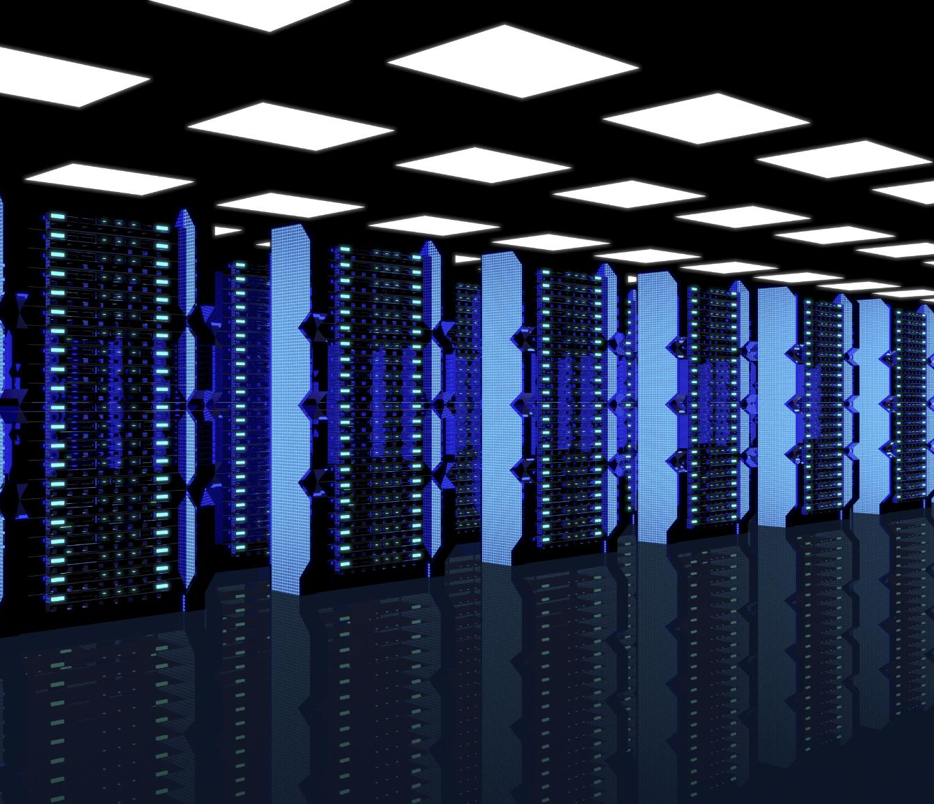
Project Scope and Objectives
Comprehensive IT Components
The project covers hardware, software, networking, security, backup, and IT support for a secure SME environment.
Network and Security Design
Focus on LAN, Wi-Fi segmentation, firewall protection, identity management, and endpoint security.
Backup and Disaster Recovery
Ensuring data safety through backup solutions and disaster recovery plans to minimize downtime.
Operational Support and Objectives
Defines IT support operations, escalation paths, reliability, scalability, and alignment with business goals.
Notes:
The scope of the IT Infrastructure and Support project encompasses all critical components required to operate a modern, secure SME IT environment. From a hardware perspective, this includes the procurement and configuration of desktops, laptops, servers, network devices, and power protection equipment. On the software side, the scope covers productivity platforms such as Microsoft 365, departmental business applications, development tools, and centralized management systems. Networking objectives include designing a structured LAN and Wi-Fi environment with proper segmentation, firewall protection, and IP addressing. Security objectives extend beyond perimeter defenses to include identity and access management, endpoint protection, data classification, and user awareness. Backup and disaster recovery form a core objective, ensuring that no single incident can permanently disrupt operations or destroy company data. Finally, the scope includes defining IT support operations, escalation paths, and troubleshooting procedures to maintain service quality. The primary objectives are to provide reliable access to systems, protect sensitive information, reduce downtime, support current workloads, and create a scalable foundation that can accommodate growth without requiring constant redesign. By clearly defining the scope and objectives, the project avoids ambiguity, aligns stakeholders, and ensures that technical decisions consistently support business priorities.

Slide 6
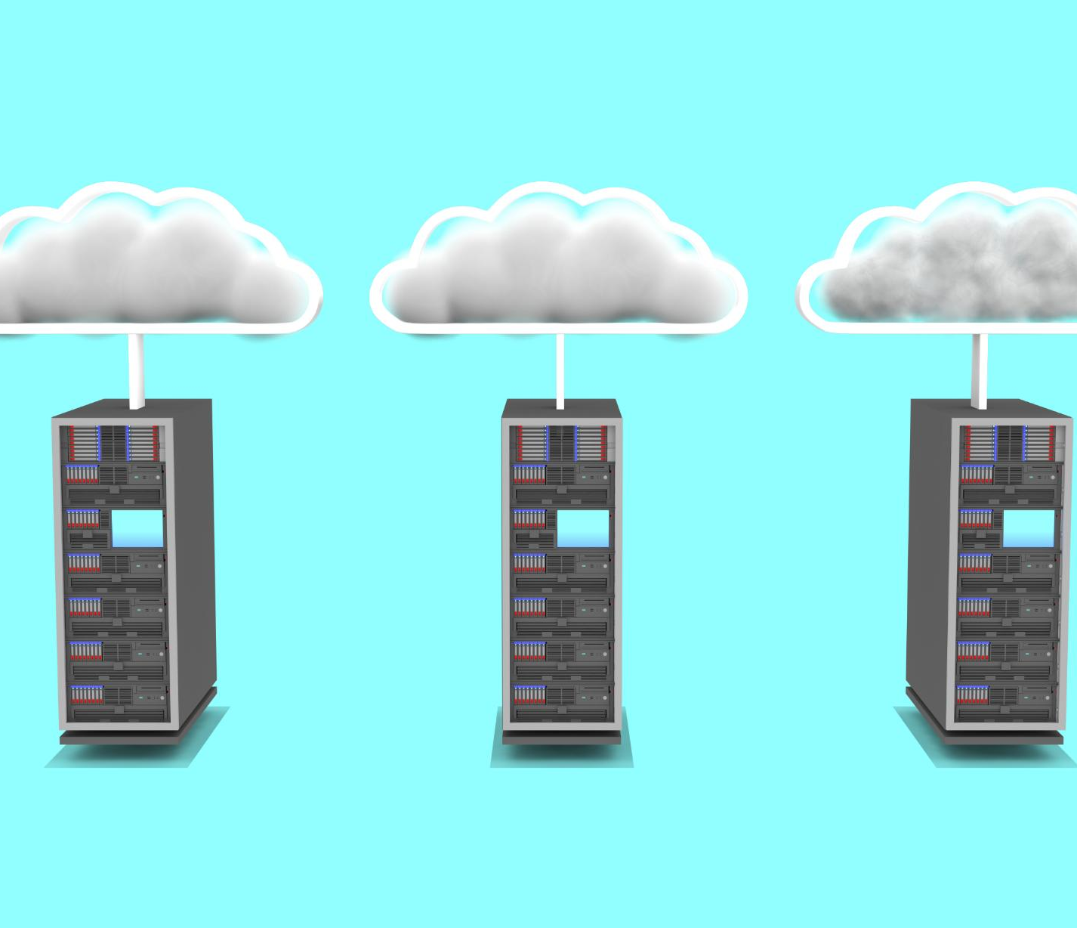
Organizational and Operational Context
Diverse Department Needs
Ubuntu Innovations has five departments with unique technology needs and risk profiles requiring tailored IT solutions.
Security and Compliance
Finance and HR need strict access controls and auditing to comply with POPIA and protect sensitive data.
Operational Challenges
South African context involves power outages and cyber threats, requiring backup systems and resilient recovery plans.
Technology Support Strategy
IT must balance security, uptime, and cost to support all departments with cloud and high-performance solutions.
Notes:
Understanding the organizational context of Ubuntu Innovations is essential to designing an effective IT infrastructure. The company employs 25 staff across five operational departments, each with distinct technology needs and risk profiles. Executives require secure, mobile access to email, documents, and reporting tools. Finance and HR departments handle highly sensitive financial and personal information, requiring strict access controls, auditing, and compliance with POPIA. Sales and Marketing rely heavily on cloud platforms, CRM systems, and external communication channels, making them high users of internet bandwidth and web services. Software developers require high-performance workstations, access to version control systems, containerization tools, and cloud environments. The IT function must manage all of these needs while maintaining security, uptime, and cost control. Additionally, the organization operates within a South African context characterized by intermittent power outages and evolving cyber threats. This operational reality necessitates UPS systems, backup connectivity, and resilient recovery plans. By aligning the infrastructure design with this organizational and environmental context, the proposed solution ensures that technology supports, rather than constrains, the daily work of Ubuntu Innovations.

Slide 7
Business Needs and Technology Foundations
Notes:
Business Needs and Assessment, Departmental Requirements Analysis, Technology Infrastructure Recommendations, Hardware and Software Foundations

Slide 8
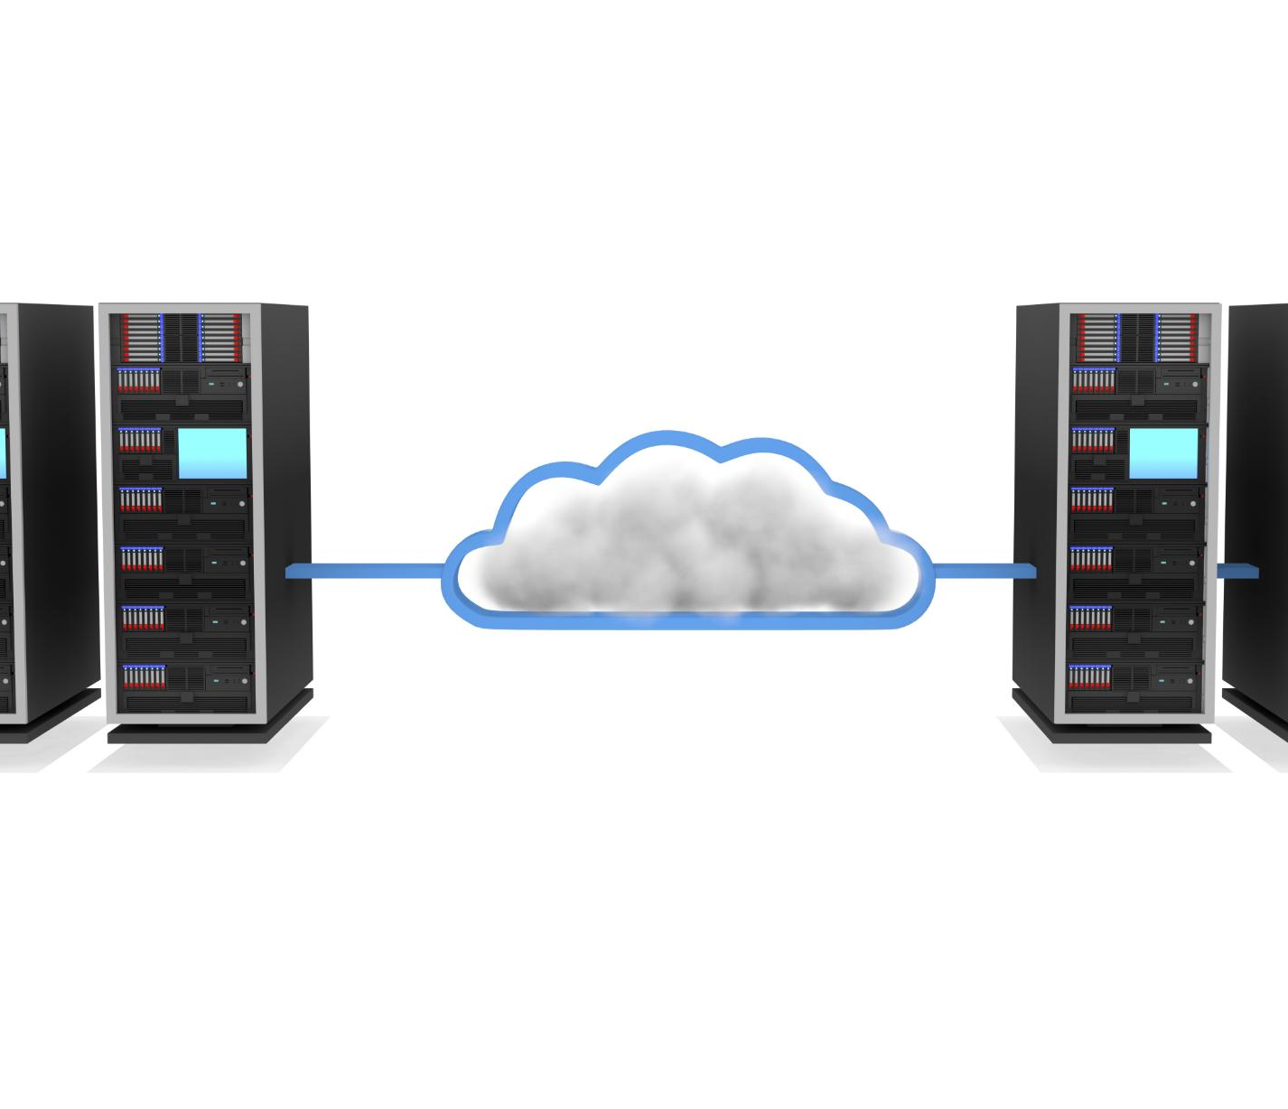
Business Needs and Assessment
Core Infrastructure Needs
Reliable computing devices and network connectivity are essential for efficient employee operations and communication.
Security and Access Controls
Security is critical due to sensitive data; role-based access controls ensure employees access only relevant information.
Scalability and Performance
Infrastructure must scale with company growth while meeting varied performance needs of different departments.
Compliance and Continuity
Compliance with data protection laws and operational continuity are vital to mitigate risks and downtime.
Notes:
The business needs assessment identifies the fundamental requirements that the IT infrastructure must satisfy to support Ubuntu Innovations’ operations. At a basic level, the organization requires reliable computing devices and network connectivity to enable employees to perform their roles efficiently. Beyond availability, security is a primary concern due to the volume of sensitive financial, personal, and intellectual property data processed daily. The assessment highlights the need for role-based access controls to ensure employees can only access information relevant to their responsibilities. Scalability is another critical need, as the company anticipates growth in staff numbers, projects, and data volumes. The infrastructure must therefore accommodate expansion without significant reconfiguration. Performance requirements vary by department, with developers needing high-spec hardware and stable network access, while sales teams prioritize mobility and cloud access. The assessment also considers compliance obligations under POPIA, requiring safeguards for personal information. Finally, operational continuity is a key business need, given the potential impact of downtime caused by hardware failure, cyber incidents, or power outages. The resulting assessment forms the basis for all subsequent design decisions, ensuring that technology investments directly address real business risks and operational demands.

Slide 9
Departmental Requirements Analysis
Executives' IT Needs
Executives require secure laptops, mobile device management, and collaboration tools for effective decision-making and communication.
Finance Department Security
Finance depends on accounting software, secure banking access, and protected storage ensuring data confidentiality and integrity.
Human Resources Privacy
HR manages sensitive employee records and compliance documents requiring strict privacy controls and controlled access.
Sales and Marketing Tools
Sales and Marketing utilize CRM platforms, email marketing, design software, and reliable internet to drive revenue.
Developer Infrastructure
Developers require powerful workstations, version control, container platforms, cloud consoles, and network isolation for risk reduction.
IT Staff Management
IT staff need administrative access, monitoring tools, and documentation repositories to effectively manage infrastructure.
Notes:
Each department within Ubuntu Innovations has unique IT requirements that influence the overall infrastructure design. Executives require secure laptops, mobile device management, and reliable access to collaboration tools for decision-making and stakeholder communication. The Finance department depends on accounting software, secure access to banking platforms, and protected storage for financial records, making data confidentiality and integrity paramount. Human Resources manages employee records, contracts, and compliance documentation, necessitating strict privacy controls and controlled access. Sales and Marketing teams rely on CRM platforms, email marketing tools, design software, and constant internet connectivity to drive revenue generation. Software developers require powerful workstations, access to version control systems, containerization platforms, and cloud consoles, along with network isolation to reduce risk exposure. IT staff require administrative access, monitoring tools, and documentation repositories to manage the environment effectively. By documenting these departmental needs in detail, the infrastructure design avoids a one-size-fits-all approach and instead delivers tailored solutions that optimize productivity while maintaining security and governance.

Slide 10
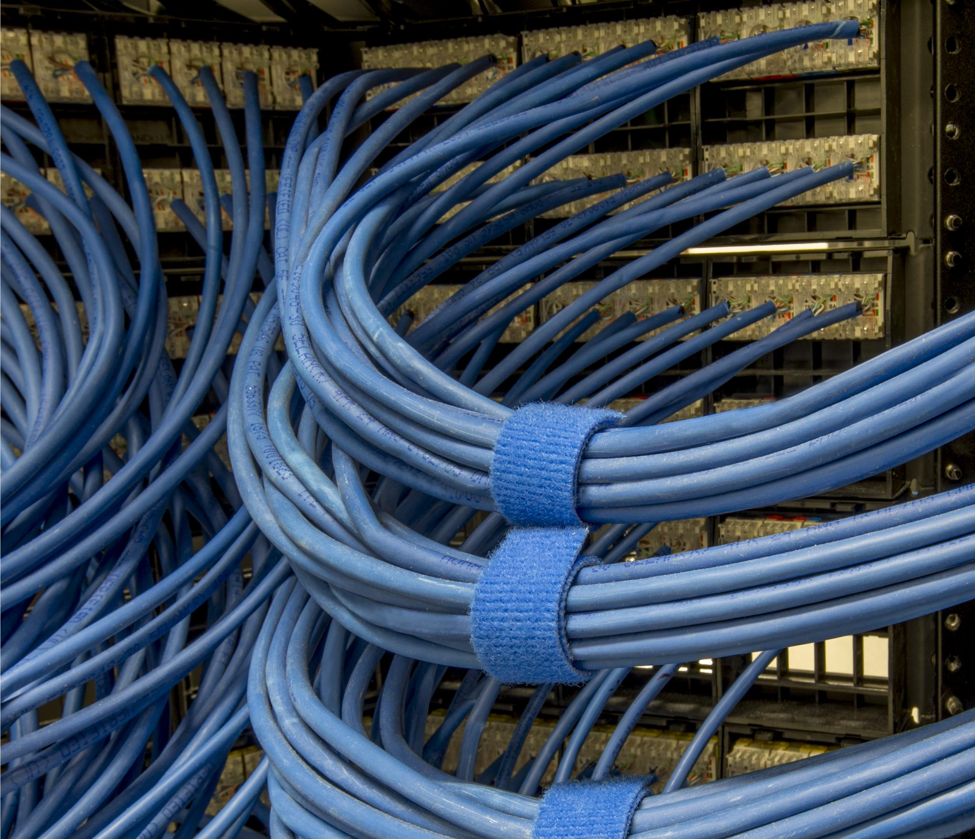
Technology Infrastructure Recommendations
Core Productivity Platform
Microsoft 365 provides essential tools for email, document collaboration, and communication across departments.
Centralized Identity Management
Active Directory enables secure and consistent identity and access management policies across the organization.
Data Storage and Backup
Network-Attached Storage offers centralized file storage with local backup to ensure data availability and security.
Network Security and Connectivity
Managed network with firewall, switches, Wi-Fi access points, UPS, and LTE failover ensures secure and reliable connectivity.
Notes:
Based on the assessed business and departmental needs, a set of technology infrastructure recommendations has been defined. Microsoft 365 is recommended as the core productivity platform, providing email, document collaboration, and communication tools. Active Directory is proposed for centralized identity and access management, enabling consistent enforcement of security policies. A Network-Attached Storage (NAS) system provides centralized file storage and local backup capabilities. Enterprise-grade endpoint protection software ensures that all devices are protected against malware and unauthorized activity. A managed network environment, including firewall, switches, and Wi-Fi access points, delivers secure and reliable connectivity. UPS systems protect critical equipment from power disruptions, while LTE failover provides internet redundancy. These recommendations balance functionality, security, and cost-effectiveness, leveraging widely adopted technologies with strong vendor support and proven reliability in SME environments.

Slide 11

Hardware and Software Foundations
Standardized Hardware Specifications
Consistent hardware specifications ensure reliable performance and simplify technical support across departments.
Server and NAS Roles
Servers manage directory services and file storage, while NAS systems provide shared data access and backups.
Licensed Software and Deployment
Licensed business applications reduce legal risks and centralized deployment ensures software consistency across devices.
Stable Platform for Advanced Capabilities
Hardware and software foundations support advanced features like security monitoring, automation, and analytics for robust infrastructure.
Notes:
The hardware and software foundations form the physical and logical base of the IT environment. Standardized hardware specifications ensure consistent performance and simplify support. Workstations are selected according to departmental needs, with higher specifications allocated to developers. Servers provide directory services and file storage, while the NAS supports shared data and backups. On the software side, licensed business applications replace ad-hoc tools, reducing legal and security risks. Centralized software deployment and patching ensure consistency across devices. Together, these foundations create a stable platform upon which more advanced capabilities such as security monitoring, automation, and analytics can be built, ensuring the infrastructure remains robust and manageable over time.

Slide 12
Network Architecture and Access Control
Notes:
Proposed Network Infrastructure, IP Addressing Scheme, Network Segmentation Strategy, Access Management and RBAC

Slide 13
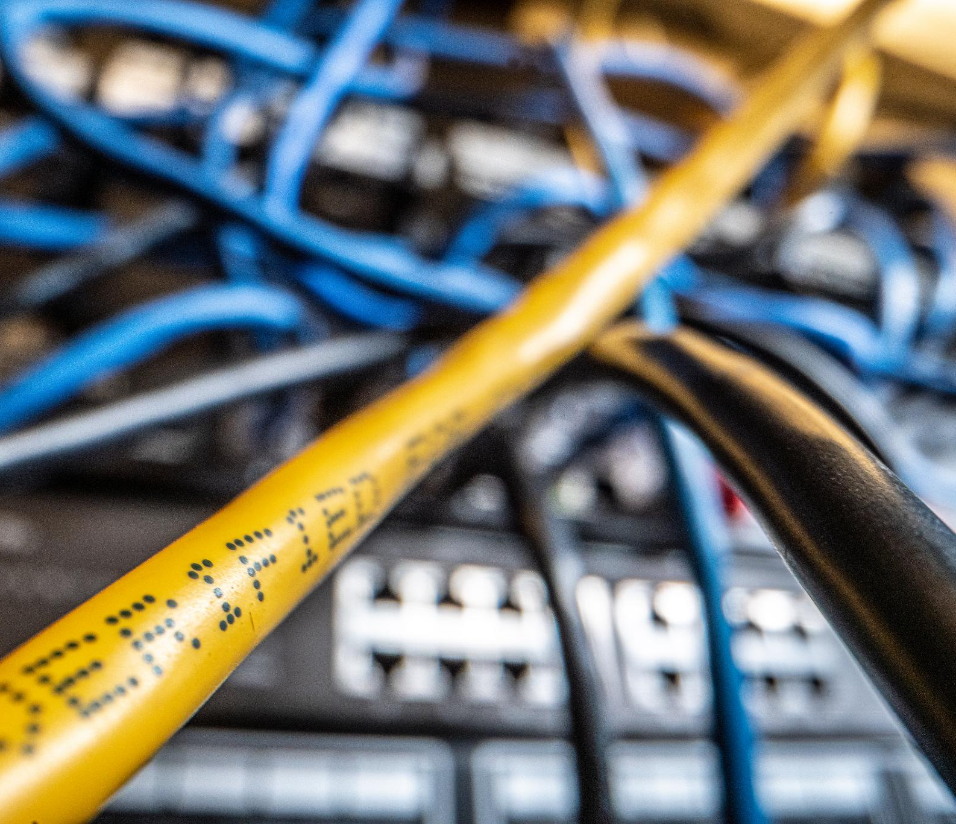
Proposed Network Infrastructure
Reliable Connectivity
Primary fibre connection with LTE failover ensures continuous internet access during outages.
Network Security
Dedicated firewall appliance manages perimeter security, VPN access, and traffic filtering.
Managed Network Distribution
Core switch distributes connectivity to wired devices and Wi-Fi access points with VLANs and QoS controls.
Secure Server Environment
Servers and NAS devices are secured in a controlled access room with power protection.
Notes:
The proposed network infrastructure is designed to deliver secure, high-performance connectivity across the Ubuntu Innovations office. Internet access is provided via a primary fibre connection with LTE failover to ensure continuity during outages. A dedicated firewall appliance enforces perimeter security, VPN access, and traffic filtering. A managed core switch distributes network connectivity to wired devices and Wi-Fi access points, supporting VLAN configuration and quality-of-service controls. Wireless coverage is provided through enterprise-grade access points supporting modern encryption standards. Central servers and NAS devices are housed in a secure server room with controlled access and power protection. This structured network design replaces flat, unmanaged networks with a clearly defined architecture that simplifies administration, enhances security, and supports future expansion.

Slide 14
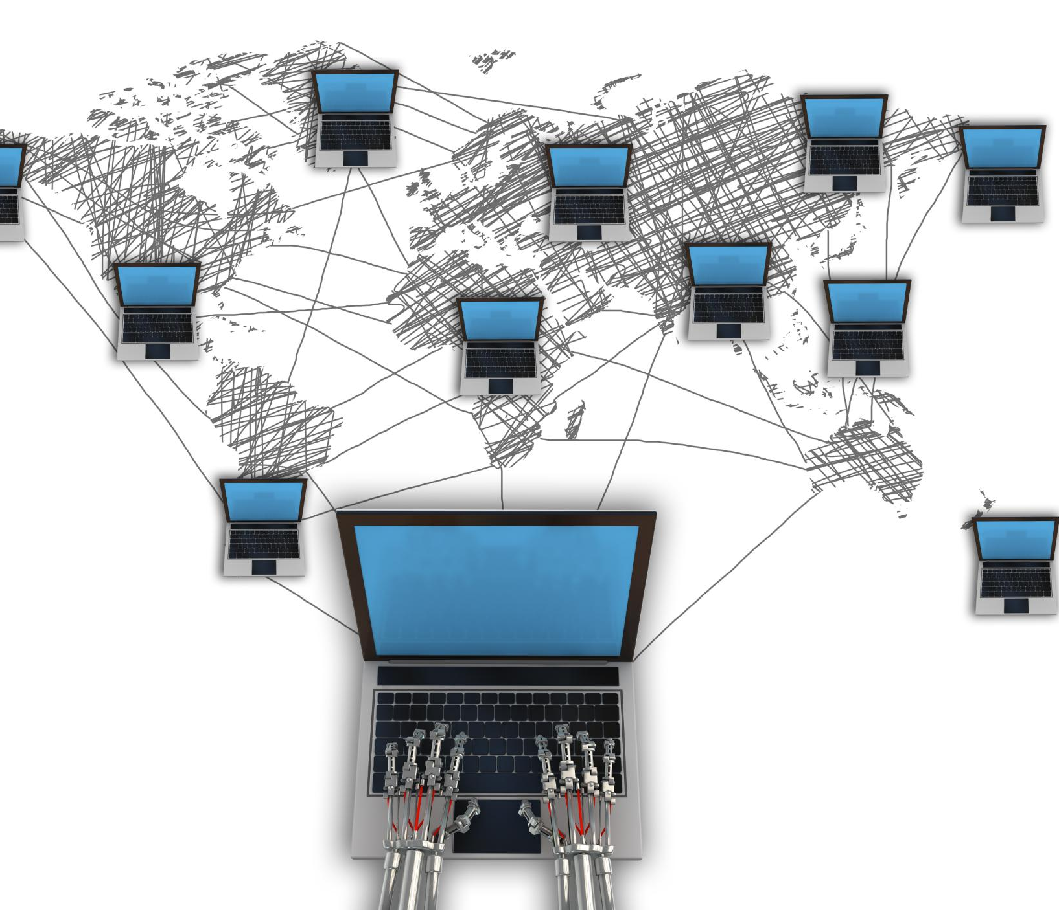
IP Addressing Scheme
Structured IP Segmentation
Private IP ranges are segmented by device function to organize network structure effectively.
Role-Based IP Identification
IP addresses indicate device roles, simplifying firewall rule application at the subnet level.
Enhanced Network Efficiency
Subnetting reduces broadcast traffic and limits threat spread across the network segments.
Scalability and Documentation
Consistent IP allocation supports network documentation, monitoring, and future scalability.
Notes:
A structured IP addressing scheme is essential for efficient network management and troubleshooting. The proposed design uses private IP ranges segmented by function, with dedicated subnets for servers, user workstations, printers and peripherals, guest Wi-Fi, and IoT or management devices. This approach allows administrators to identify a device’s role based on its IP address and apply firewall rules at a subnet level rather than per device. It also reduces broadcast traffic and limits the spread of potential threats. Consistent IP allocation supports documentation, monitoring, and long-term scalability, ensuring that the network remains orderly as new devices and services are introduced.

Slide 15
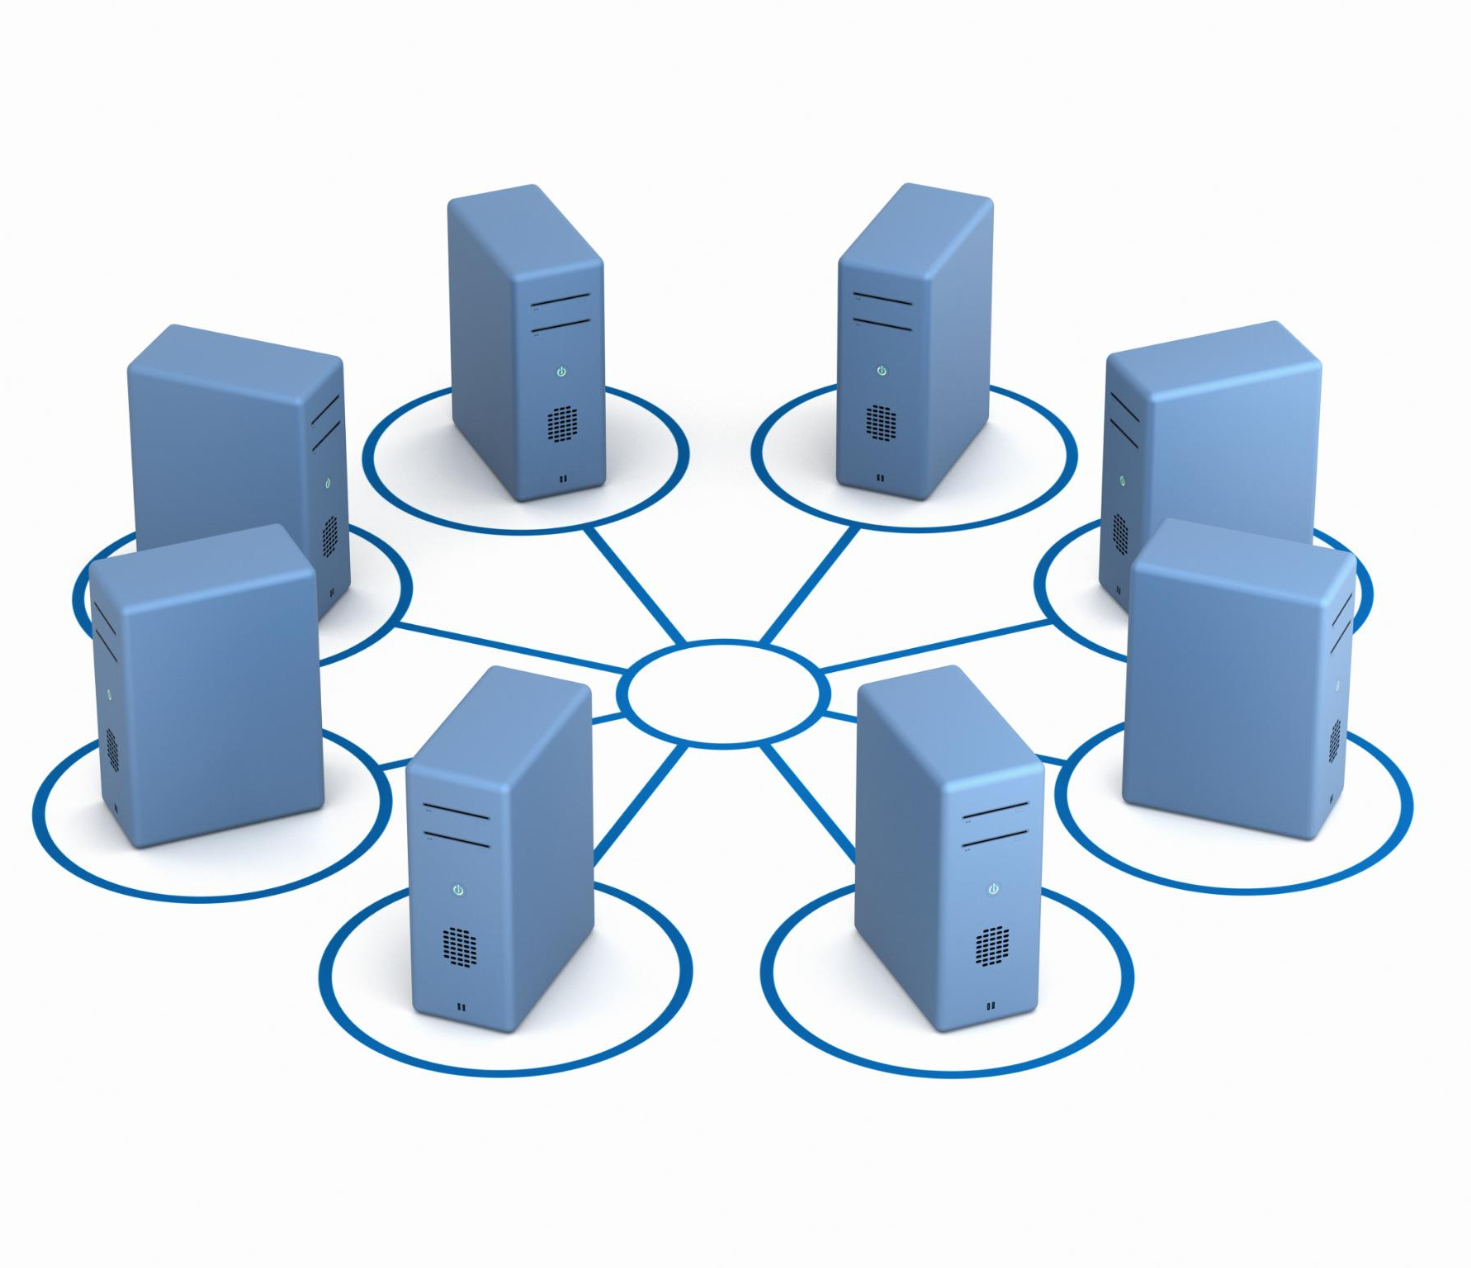
Network Segmentation Strategy
Isolated Network Zones
Segmentation divides the network into isolated zones based on device type and risk profile to enhance security.
Reduced Attack Surface
Separating network segments limits lateral movement and reduces the overall attack surface of the network.
Improved Network Performance
Segmenting networks isolates broadcast domains, improving overall network performance and efficiency.
Simplified Access Controls
Segmentation enables simpler and specific firewall policies, restricting access by network segment.
Notes:
Network segmentation divides the network into isolated zones based on device type and risk profile. By separating servers, user devices, guest networks, and IoT systems, the organization reduces the attack surface and limits lateral movement in the event of a breach. Segmentation also improves performance by isolating broadcast domains and enables simpler firewall policies. For example, guest Wi-Fi can be completely blocked from accessing internal resources, while finance systems can be restricted to specific subnets. This strategy reflects best practices in modern network security and is particularly important for organizations handling sensitive data.

Slide 16

Access Management and RBAC
Role-Based Access Control
RBAC assigns permissions to groups instead of individual users, simplifying access management and enhancing security.
Simplified Onboarding and Offboarding
Adjusting group memberships streamlines user onboarding and offboarding processes effectively.
Separation of Administrative Accounts
Separate administrative and day-to-day accounts to reduce security risks and limit exposure.
Principle of Least Privilege
Enforcing least privilege restricts access to only what is necessary, improving security and clarity.
Notes:
Access management is implemented using Role-Based Access Control (RBAC), where permissions are assigned to security groups rather than individual users. Each department is mapped to specific groups that control access to file shares, applications, and systems. This approach simplifies onboarding and offboarding, as administrators only need to adjust group memberships. It also improves auditability and reduces the risk of excessive privileges. Administrative accounts are separated from day-to-day user accounts to minimize exposure. By enforcing the principle of least privilege, RBAC ensures that users have only the access required to perform their roles, enhancing both security and operational clarity.

Slide 17
Data Storage and Business Continuity
Notes:
NAS Storage Architecture, Folder Structure and Data Governance, Business Continuity Strategy, Backup and Disaster Recovery Framework

Slide 18
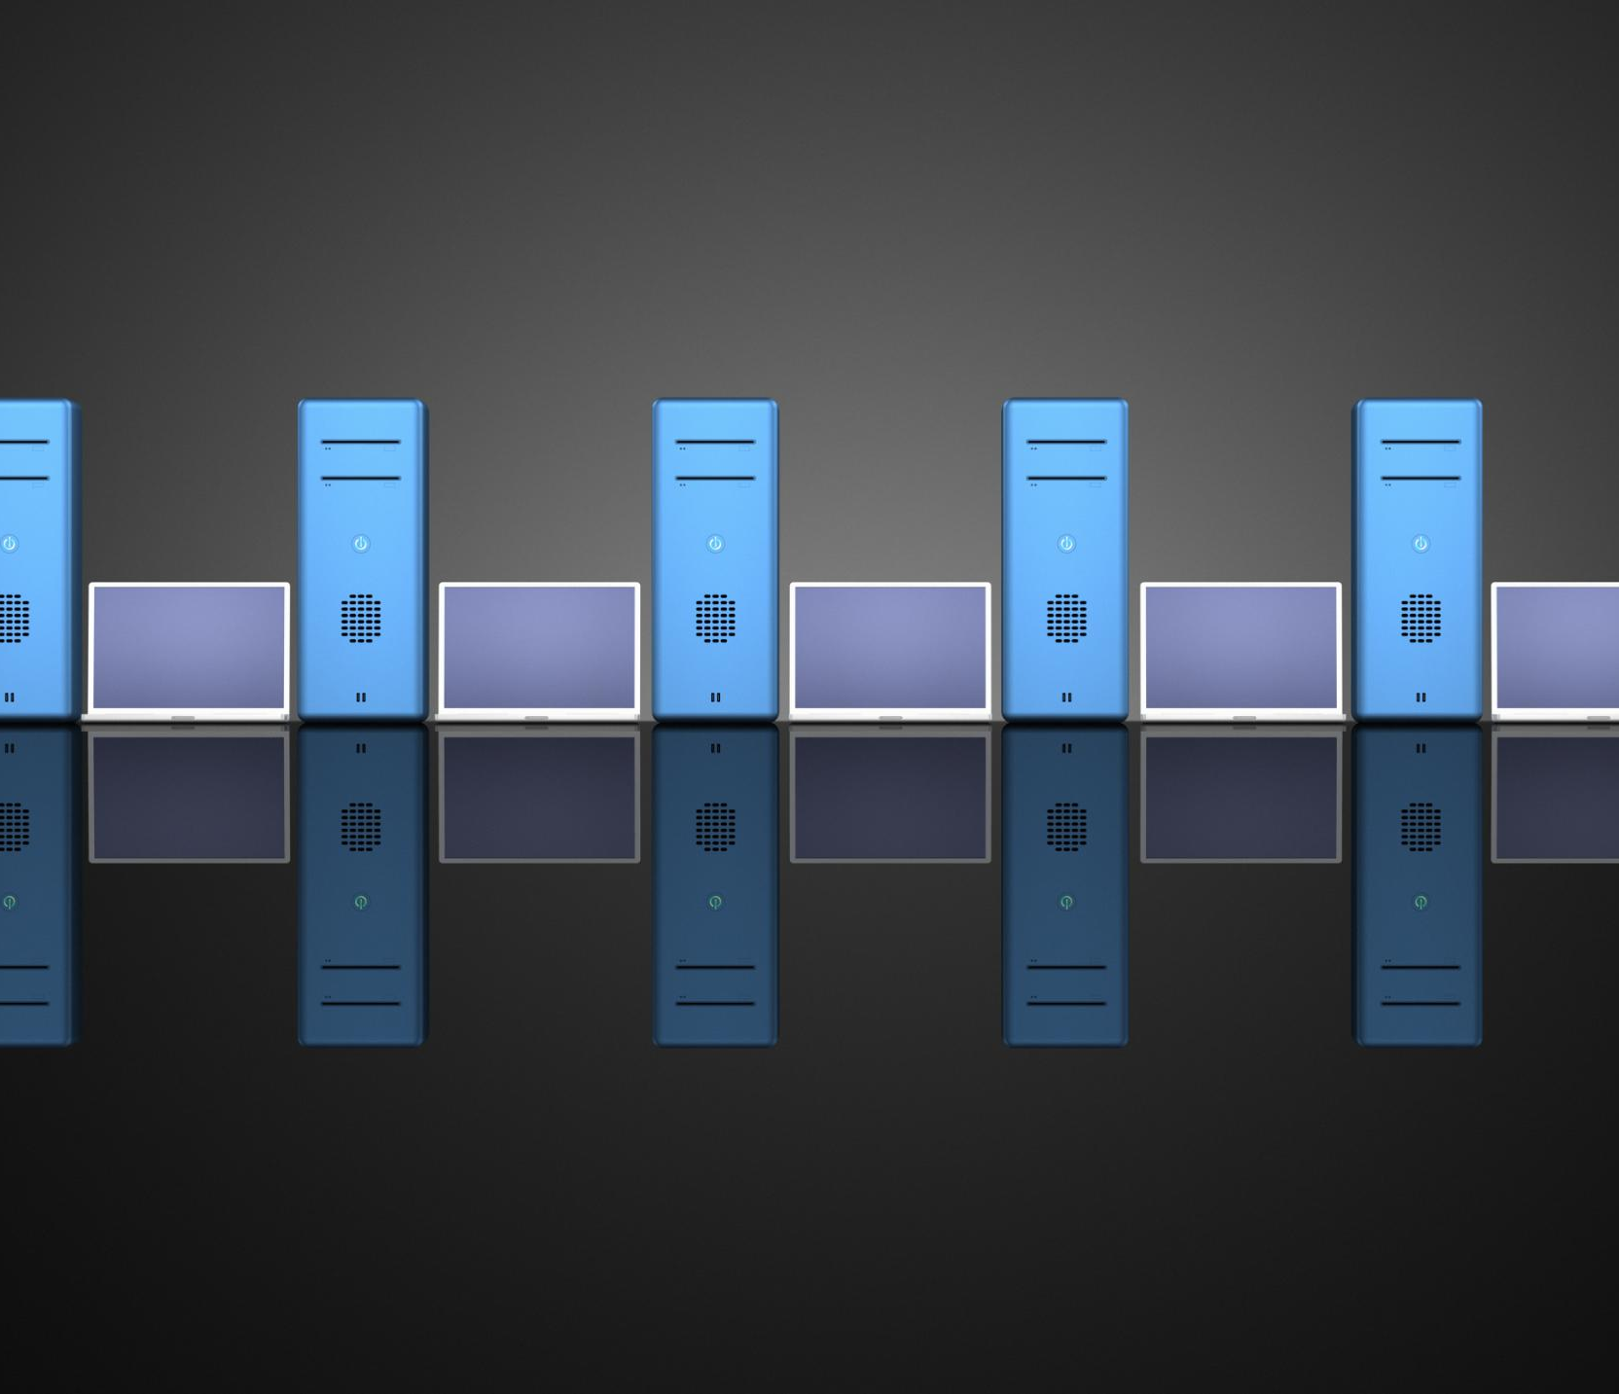
NAS Storage Architecture
Centralized Data Storage
NAS centralizes all company data under a single root directory with organized subfolders, enhancing data organization.
Access Control and Security
Sensitive departments like Finance and HR are logically isolated to ensure confidentiality and secure access control.
Backup and Recovery
NAS functions as a local backup target, enabling quick recovery from accidental deletions or minor incidents.
Reduced Data Sprawl
Centralizing storage reduces data sprawl and improves visibility of critical information locations within the organization.
Notes:
The Network-Attached Storage (NAS) architecture provides centralized, secure file storage for Ubuntu Innovations. All company data resides under a single root directory with standardized subfolders for departments and projects. This structure improves data organization, simplifies access control, and supports automated backup processes. Sensitive departments such as Finance and HR are logically isolated to ensure confidentiality. The NAS also serves as a local backup target, enabling rapid recovery from accidental deletions or minor incidents. By centralizing storage, the organization reduces data sprawl and improves visibility into where critical information resides.

Slide 19

Folder Structure and Data Governance
Standardized Folder Structure
A clear directory hierarchy reduces misfiling and accidental data exposure by specifying allowed data types per folder.
Naming Conventions
Consistent naming conventions ensure compatibility with automation tools and simplify data management.
Roles and Responsibilities
Department managers act as data owners while IT oversees infrastructure to maintain data governance.
Archival and Compliance
Archival directories store historical data in read-only format to support compliance and lifecycle management.
Notes:
A standardized folder structure and clear data governance rules are essential for maintaining order and security. The defined directory hierarchy specifies what types of data may be stored in each location, reducing misfiling and accidental exposure. Naming conventions ensure consistency and compatibility with automation tools. Department managers act as data owners, while IT maintains the underlying infrastructure. Archival directories preserve historical data in a read-only format, supporting compliance and lifecycle management. Together, these governance measures ensure that data remains accessible, secure, and auditable over time.

Slide 20
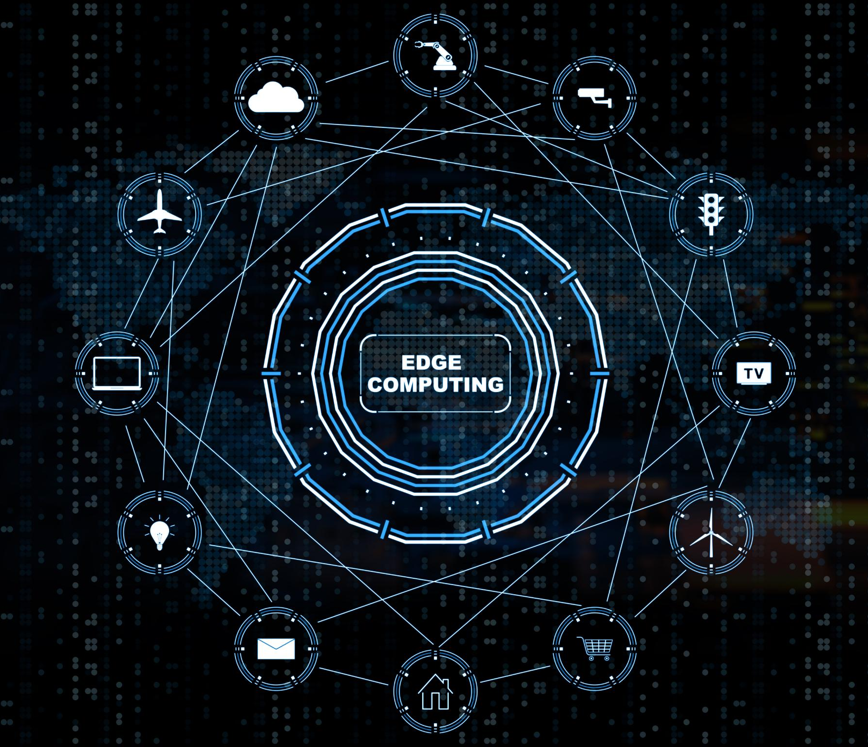
Business Continuity Strategy
Ensuring Operational Continuity
Business continuity enables ongoing operations despite disruptions like hardware failures or cyber incidents.
Key Elements of Strategy
Includes redundant connectivity, UPS protection, and documented recovery procedures for reliability.
Prioritizing Critical Systems
Identifying critical systems and recovery times ensures effective resource allocation during incidents.
Benefits of Planning
Reduces downtime, protects revenue, and maintains customer confidence as part of IT strategy.
Notes:
The business continuity strategy ensures that Ubuntu Innovations can continue operating despite disruptions such as hardware failures, cyber incidents, or power outages. Key elements include redundant connectivity, UPS protection, and documented recovery procedures. By identifying critical systems and defining acceptable recovery times, the organization prioritizes resources effectively during an incident. Business continuity planning reduces downtime, protects revenue, and maintains customer confidence, making it a critical component of the overall IT strategy.

Slide 21
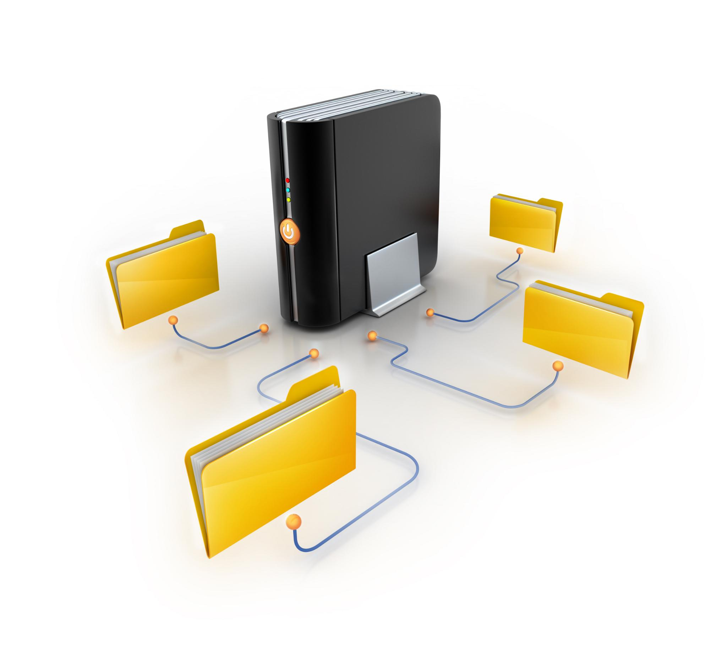
Backup and Disaster Recovery Framework
3-2-1-1 Backup Rule
The 3-2-1-1 rule ensures multiple data copies on diverse media including off-site and immutable storage.
Regular Backup Scheduling
Consistent backup schedules help protect data from loss through regular and automated copies.
Disaster Recovery Procedures
Documented procedures guide controlled restoration of systems after data loss or catastrophic events.
Testing and Verification
Regular testing confirms backups are usable and recovery objectives can be reliably met.
Notes:
The backup and disaster recovery framework is built around the 3-2-1-1 rule, ensuring multiple copies of data across different media, including off-site and immutable storage. Regular backup schedules protect against data loss, while documented disaster recovery procedures guide the restoration of systems in a controlled manner. Testing and verification confirm that backups are usable and recovery objectives can be met. This framework significantly reduces the impact of ransomware, accidental deletion, and catastrophic events.

Slide 22
Cybersecurity and Risk Management
Notes:
Cybersecurity Framework Overview, Security Policies and Controls, Risk Management and Threat Landscape, Incident Response Planning

Slide 23

Cybersecurity Framework Overview
Framework Standards Alignment
The framework aligns with ISO/IEC 27001 and NIST standards to provide a recognized cybersecurity structure.
Core Cybersecurity Functions
It involves identifying, protecting, detecting, responding, and recovering from cyber threats systematically.
Defense in Depth Strategy
Policies, technical controls, and user awareness combine to ensure comprehensive protection against failures.
Notes:
The cybersecurity framework adopted for Ubuntu Innovations is designed to protect the confidentiality, integrity, and availability of information systems. It aligns with recognized standards such as ISO/IEC 27001 and the NIST Cybersecurity Framework, providing a structured approach to identifying, protecting against, detecting, responding to, and recovering from cyber threats. Policies, technical controls, and user awareness all contribute to defense in depth, ensuring that no single failure compromises the entire environment.

Slide 24
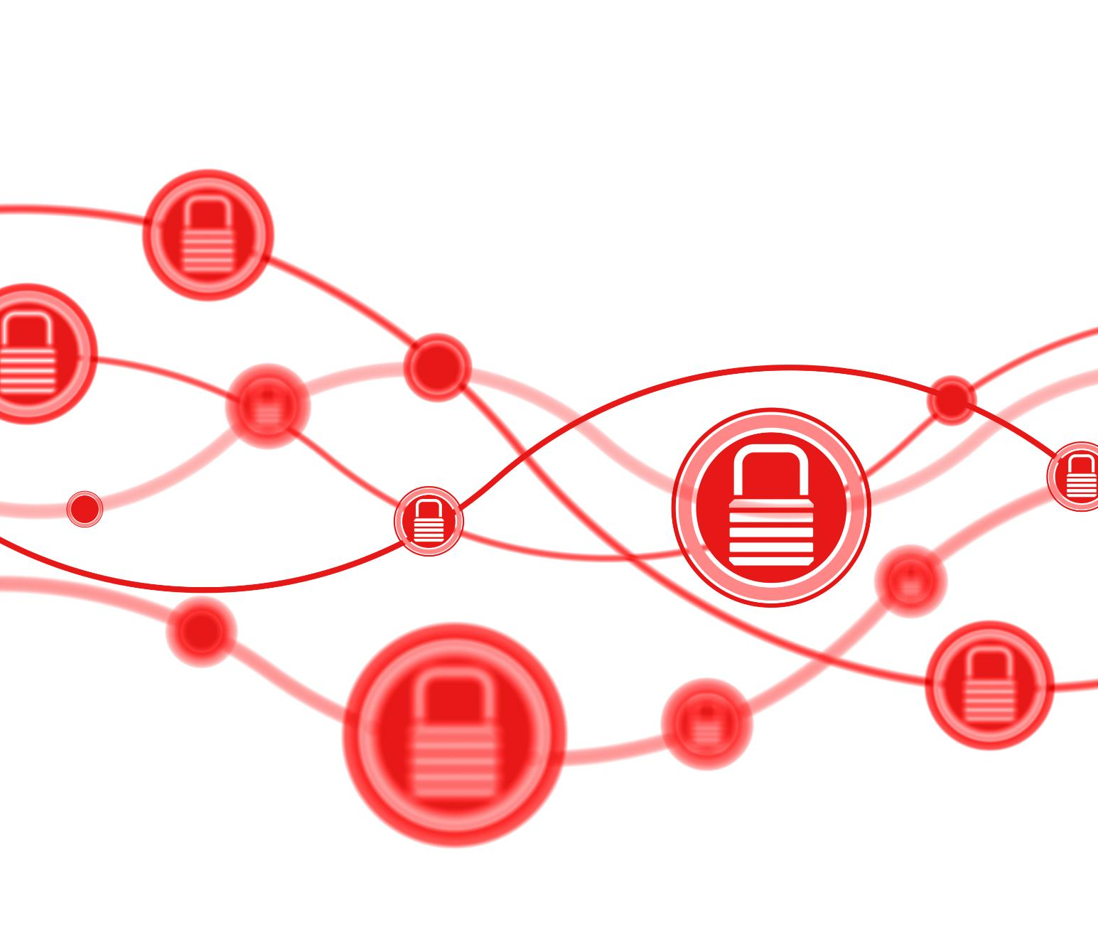
Security Policies and Controls
Defining Security Policies
Security policies specify acceptable use, password rules, device security, and data handling protocols.
Technical Security Controls
Controls like firewalls, endpoint detection, and encryption enforce security policies in real time.
Ongoing Policy Review
Regular reviews ensure security controls adapt effectively to evolving cyber threats.
Communication and Compliance
Clear communication and enforcement reduce risks of security incidents from human errors.
Notes:
Security policies define acceptable use, password standards, device security requirements, and data handling procedures. Technical controls such as endpoint detection, firewalls, and encryption enforce these policies in practice. Regular reviews ensure that controls remain effective as threats evolve. By clearly communicating expectations and enforcing compliance, the organization reduces the likelihood of security incidents caused by human error or misconfiguration.

Slide 25
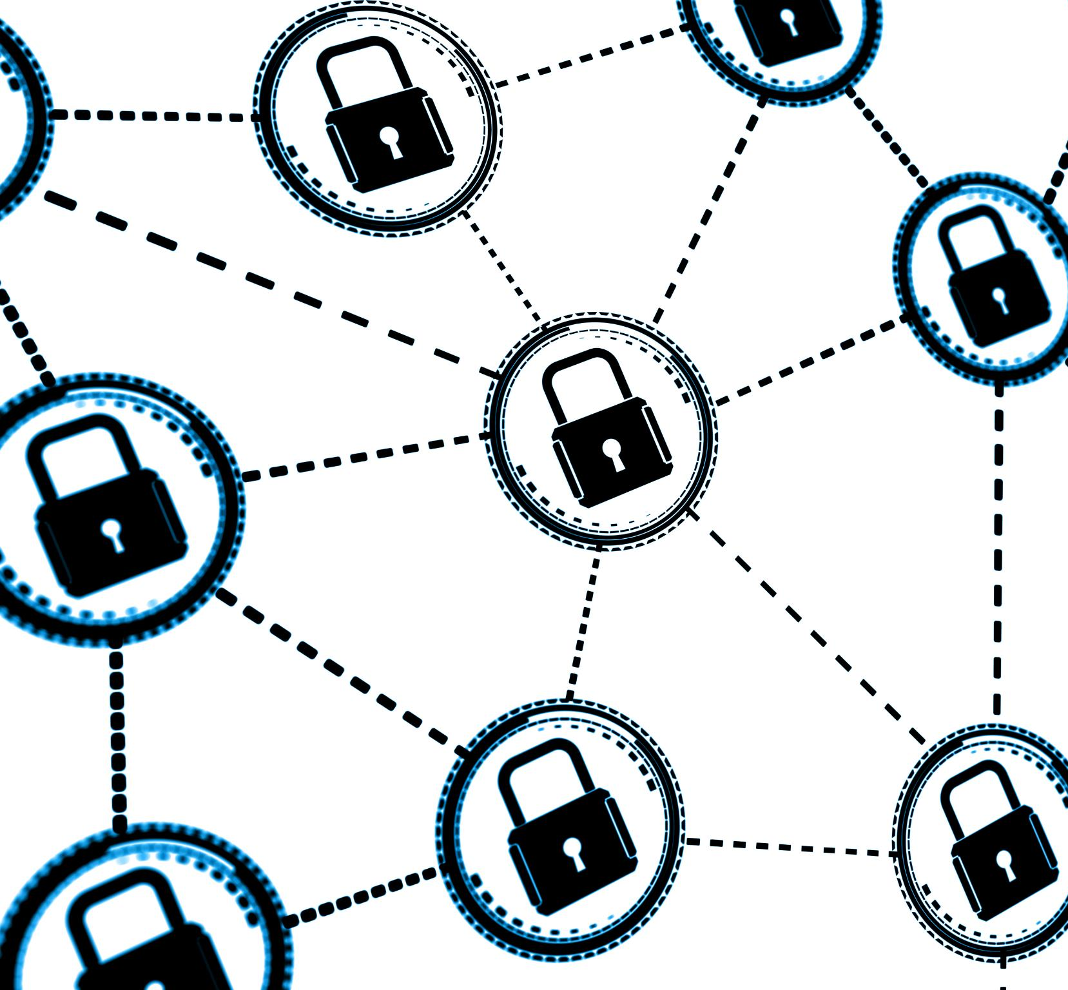
Risk Management and Threat Landscape
Threat Identification
Identify various threats like phishing, ransomware, insider misuse, and device theft to understand potential risks.
Risk Assessment
Assess risks by evaluating their likelihood and potential impact to prioritize mitigation efforts effectively.
Mitigation Strategies
Apply appropriate mitigation strategies with immediate focus on high risks and monitoring medium risks.
Notes:
Risk management involves identifying and prioritizing threats such as phishing, ransomware, insider misuse, and device theft. Each risk is assessed based on likelihood and impact, with mitigation strategies assigned accordingly. High-risk threats receive immediate attention, while medium risks are monitored and addressed through reasonable controls. This structured approach ensures that security investments are proportionate and focused on the most significant exposures.

Slide 26
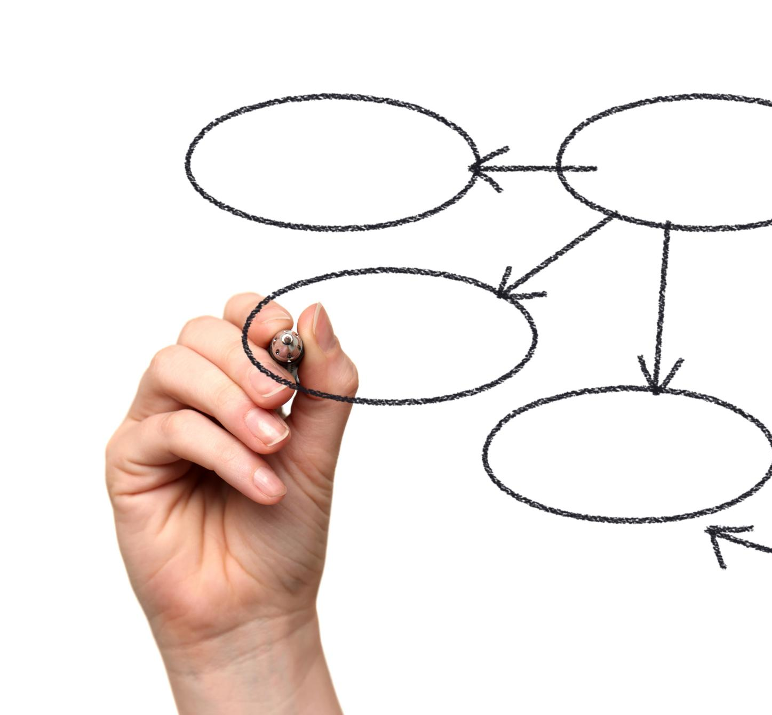
Incident Response Planning
Defined Roles and Actions
Incident response plans clearly outline roles, escalation paths, and necessary actions during security incidents.
Structured Incident Lifecycle
Following preparation, detection, containment, eradication, recovery, and lessons learned ensures effective incident management.
Continuous Improvement
Regular testing and post-incident reviews enhance readiness and strengthen security posture over time.
Notes:
The incident response plan defines roles, escalation paths, and actions to be taken during a security event. Following a structured lifecycle—preparation, detection, containment, eradication, recovery, and lessons learned—ensures a calm and effective response. Regular testing and post-incident reviews improve readiness and strengthen the organization’s overall security posture.

Slide 27
IT Support and Operations
Notes:
IT Support Operations Model, Common IT Issues and Troubleshooting, Support Workflow and Escalation, Operational Governance

Slide 28

IT Support Operations Model
Tier 1 Support
Tier 1 focuses on common user issues like password resets and printer problems, ensuring quick initial help.
Tier 2 Support
Tier 2 handles complex technical problems such as network failures and hardware faults requiring specialized knowledge.
Tier 3 Support
Tier 3 involves senior IT staff or external vendors managing critical incidents and advanced problem resolution.
Notes:
The IT support operations model is structured into three tiers to ensure efficient issue resolution. Tier 1 handles common user issues such as password resets and printer problems. Tier 2 addresses more complex technical issues, including network and hardware faults. Tier 3 involves senior IT staff or vendors for critical incidents. This model ensures that problems are resolved at the appropriate level, reducing downtime and support costs.

Slide 29
Common IT Issues and Troubleshooting
Typical IT Issues
Frequent problems include printer connectivity failures, user account lockouts, and slow system performance affecting productivity.
Troubleshooting Procedures
Standardized steps ensure consistent diagnosis and resolution of IT issues by support teams, improving efficiency.
Incident Documentation
Recording incidents helps track trends and drives ongoing improvements in IT system reliability and user experience.
Notes:
Common IT issues include printer connectivity problems, account lockouts, and slow system performance. Standardized troubleshooting procedures guide support staff through diagnosis and resolution, ensuring consistency and efficiency. Documentation of incidents supports trend analysis and continuous improvement of the IT environment.

Slide 30
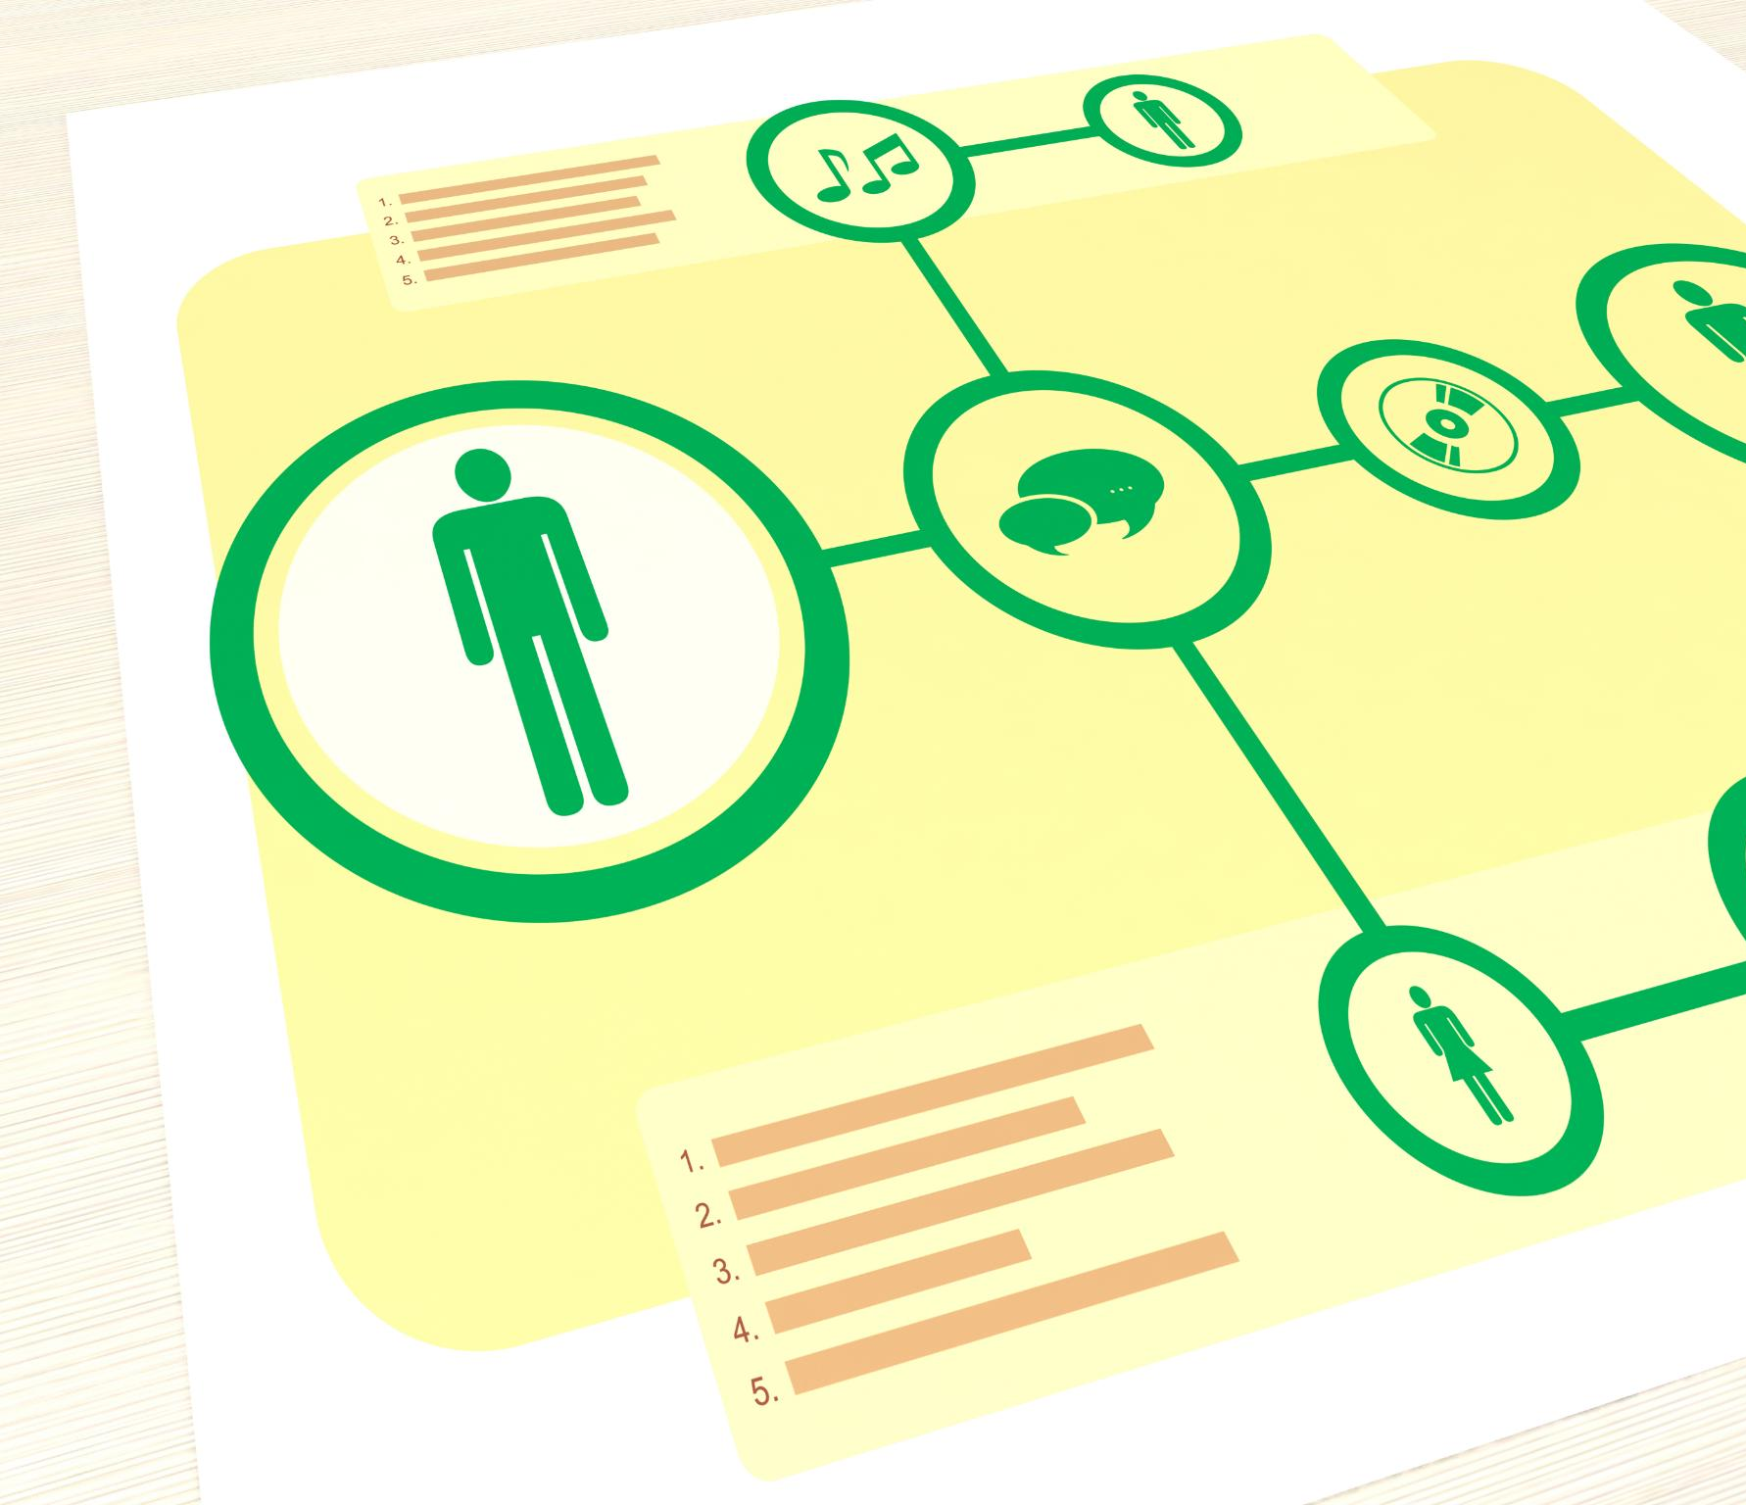
Support Workflow and Escalation
Issue Identification and Logging
Support workflow starts with identifying and logging issues for proper handling and tracking.
Diagnosis and Resolution
Diagnosing problems and delivering timely resolutions are critical for effective support services.
Escalation and Accountability
Clear escalation timelines ensure accountability and prevent delays in issue resolution.
Insight Through Tracking
Tracking incidents provides valuable insights to identify recurring issues and improve support proactively.
Notes:
The support workflow begins with issue identification and logging, followed by diagnosis, resolution, and documentation. Clear escalation timelines prevent delays and ensure accountability. By tracking incidents and resolutions, IT gains insight into recurring issues and opportunities for proactive improvement.

Slide 31

Operational Governance
Roles and Responsibilities
Defines clear roles for IT staff, managers, and end-users to ensure smooth operational governance.
Change Management
Regular reviews and structured change management maintain alignment with business needs and policies.
Transparency and Accountability
Governance ensures transparency and accountability across all IT operational activities.
Notes:
Operational governance defines roles and responsibilities for IT, managers, and end-users. Regular reviews, change management processes, and documentation ensure that the IT environment remains aligned with business needs and compliant with policies. Governance provides transparency and accountability across all operational activities.

Slide 32
Business Value and Cost Efficiency
Notes:
Business Value Delivered, Productivity and Performance Gains, Cost Efficiency and Optimization, Risk Reduction and Compliance Benefits

Slide 33

Business Value Delivered
Reliability and Stability
Improved IT infrastructure ensures stable systems, minimizing downtime and enhancing employee productivity.
Enhanced Security
Clear access controls and data protection measures increase management's confidence in security and compliance.
Operational Efficiency
Faster issue resolution supports revenue growth and streamlines business operations effectively.
Notes:
The proposed IT infrastructure delivers significant business value by improving reliability, security, and productivity. Employees benefit from stable systems and clear access controls, while management gains confidence in data protection and compliance. Reduced downtime and faster issue resolution directly support revenue generation and operational efficiency.

Slide 34
Productivity and Performance Gains
Standardized Hardware Benefits
Standardized hardware creates a consistent and reliable environment that boosts employee productivity across departments.
Optimized Network Connectivity
Optimized networks provide reliable connectivity, enabling sales teams and other employees to work without disruptions.
Modern Software Tools
Modern software tools centralize processes, helping administrative staff improve efficiency and service quality.
Notes:
Standardized hardware, optimized networks, and modern software tools enhance employee productivity. Developers experience improved performance, sales teams benefit from reliable connectivity, and administrative staff work more efficiently with centralized systems. These gains translate into measurable improvements in output and service quality.

Slide 35

Cost Efficiency and Optimization
Leveraging Existing Platforms
Using platforms like Active Directory and Group Policy reduces the need for extra tools and cuts costs.
Centralized Management
Centralized management lowers administrative overhead and simplifies IT operations for better efficiency.
Proactive Maintenance
Proactive maintenance reduces costly outages by addressing issues before they escalate.
Scalable Design Benefits
A scalable system design leads to long-term savings and reduces risk exposure.
Notes:
Cost efficiency is achieved by leveraging existing platforms such as Active Directory and Group Policy, reducing the need for additional tools. Centralized management lowers administrative overhead, while proactive maintenance reduces costly outages. Long-term savings result from scalable design and reduced risk exposure.

Slide 36

Risk Reduction and Compliance Benefits
Operational and Regulatory Risk Reduction
Structured security, backup, and governance controls effectively reduce both operational and regulatory risks for organizations.
Compliance with POPIA
Adhering to POPIA ensures legal compliance and protects the organization from potential legal and reputational damages.
Stakeholder Trust Reinforcement
Effective governance and compliance practices build and reinforce trust among stakeholders and clients.
Notes:
By implementing structured security, backup, and governance controls, the organization significantly reduces operational and regulatory risk. Compliance with POPIA and alignment with best practices protect the company from legal and reputational harm, reinforcing stakeholder trust.

Slide 37
Conclusion and Future Vision
Notes:
Project Conclusion, Future Vision and Scalability, Innovation and Continuous Improvement, Closing and Next Steps

Slide 38
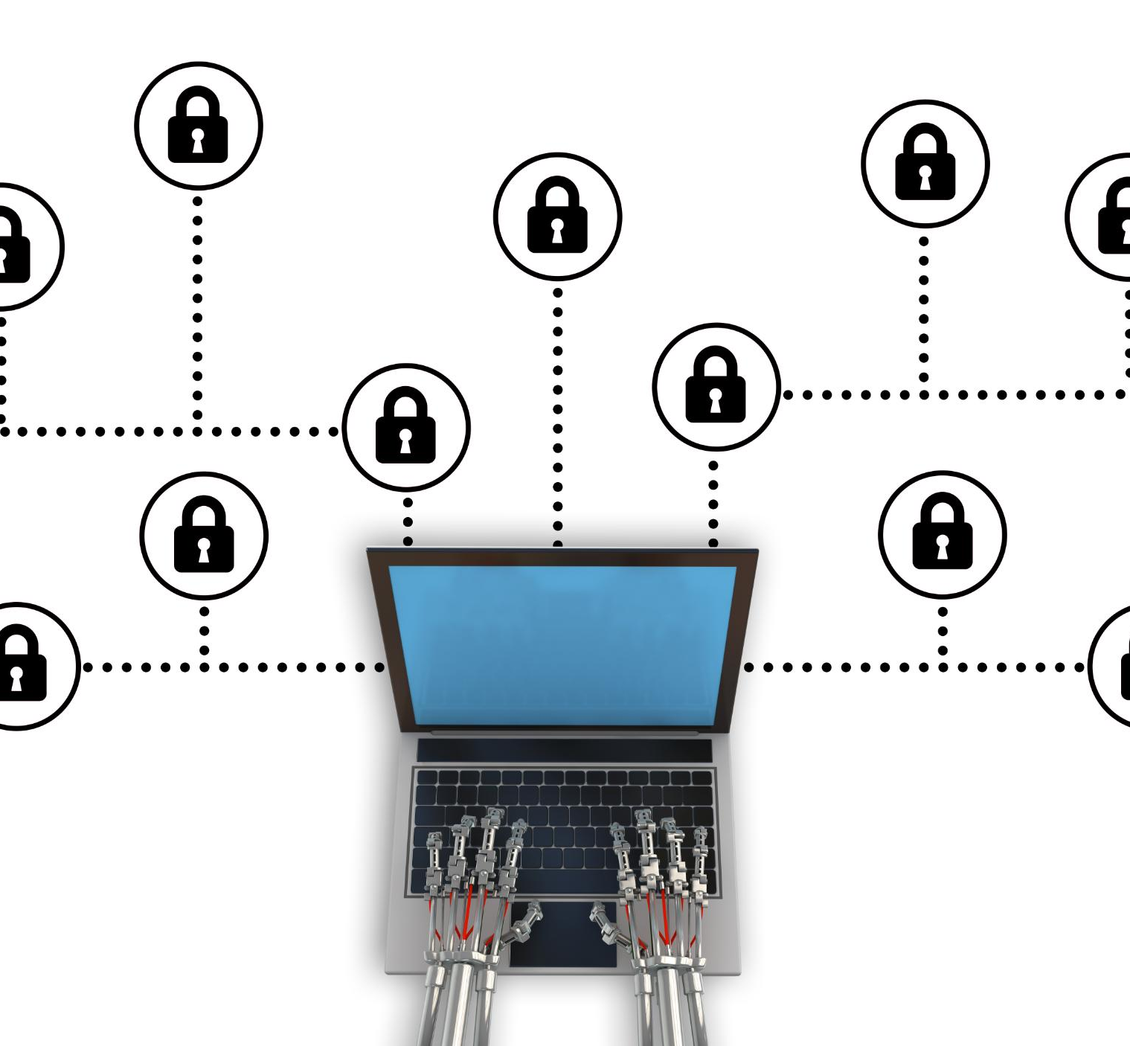
Project Conclusion
Integrated IT Solution
The project combines hardware, software, networking, security, and support into a cohesive IT infrastructure solution.
Secure and Scalable Foundation
The solution ensures a secure and scalable IT environment that supports current operations and future growth.
Risk Mitigation and Business Support
Addressing key risks enables protection of critical assets and alignment with business objectives for consistent value delivery.
Notes:
The IT Infrastructure and Support Solution for Ubuntu Innovations establishes a secure, reliable, and scalable foundation for current and future operations. By addressing hardware, software, networking, security, and support in an integrated manner, the project mitigates key risks and supports business objectives. The result is an IT environment that enables growth, protects critical assets, and delivers consistent value to the organization.

Slide 39

Future Vision and Scalability
Cloud Expansion Support
Infrastructure is built to enable seamless cloud expansion to meet growing business demands.
Increased Automation
Automation capabilities are enhanced to improve efficiency and reduce manual intervention.
Advanced Security Capabilities
Security features are advanced to protect systems while scaling operations effectively.
Continuous Improvement
Regular system reviews ensure IT infrastructure evolves alongside the growing business needs.
Notes:
Looking ahead, the infrastructure is designed to support cloud expansion, increased automation, and advanced security capabilities. As Ubuntu Innovations grows, additional users, services, and locations can be integrated without disrupting existing systems. Continuous improvement and regular reviews ensure that the IT environment evolves alongside the business.

Slide 40

Innovation and Continuous Improvement
Emerging Technologies Adoption
Adoption of cloud-native services and advanced data analytics drives technological innovation and agility.
Enhanced Monitoring
Advanced monitoring tools help detect issues early and maintain IT system resilience and performance.
Continuous Improvement Processes
Lessons learned from operations and incidents inform ongoing enhancements to keep systems competitive.
Notes:
The future vision emphasizes innovation through the adoption of emerging technologies such as cloud-native services, enhanced monitoring, and data analytics. Continuous improvement processes ensure that lessons learned from operations and incidents inform ongoing enhancements, keeping the IT environment resilient and competitive.

Slide 41

Closing and Next Steps
Final Validation
The project is entering the final validation stage to ensure all systems meet requirements and function properly.
User Onboarding
User onboarding processes will facilitate smooth adoption and usage of new IT systems across the organization.
Operational Handover
Operational handover ensures the IT infrastructure is fully transferred for ongoing support and maintenance.
Business Focus and Adaptability
With infrastructure established, focus shifts to core objectives with confidence in innovation support and adaptability.
Notes:
The next steps involve final validation, user onboarding, and operational handover. With the infrastructure in place, Ubuntu Innovations is well positioned to focus on its core business objectives, confident that its IT systems can support innovation, protect assets, and adapt to future challenges.

